Slide 1
Chapter 2: Arrays

Slide 2
Agenda
Group Presentation
What is Array
Unordered vs Ordered Array
Some implementations
Strength and weakness

Slide 3
Group Presentation
Choose a sorting algorithm, study, write report, and do a presentation in class
  Selection sort
  Bubble sort
  Insertion sort
  Merge sort
  Quick sort
  Cocktail sort
  Tim sort
  Heap sort
  Radix sort
  Counting sort
  Shell sort
  Gnome sort
  ...etc

Slide 4
The Array
Most commonly used data structure
Common operations
  Insert
  Search
  Delete
How do these differ for an ‘ordered array’?

Slide 5
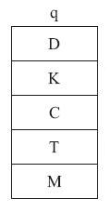
Array Storage
An array is a collection of data of the same type
Stored linearly in memory:

Slide 6
Remember, value vs. reference…
In Java:
  Data of a primitive type is a value
  All objects are references

Slide 7
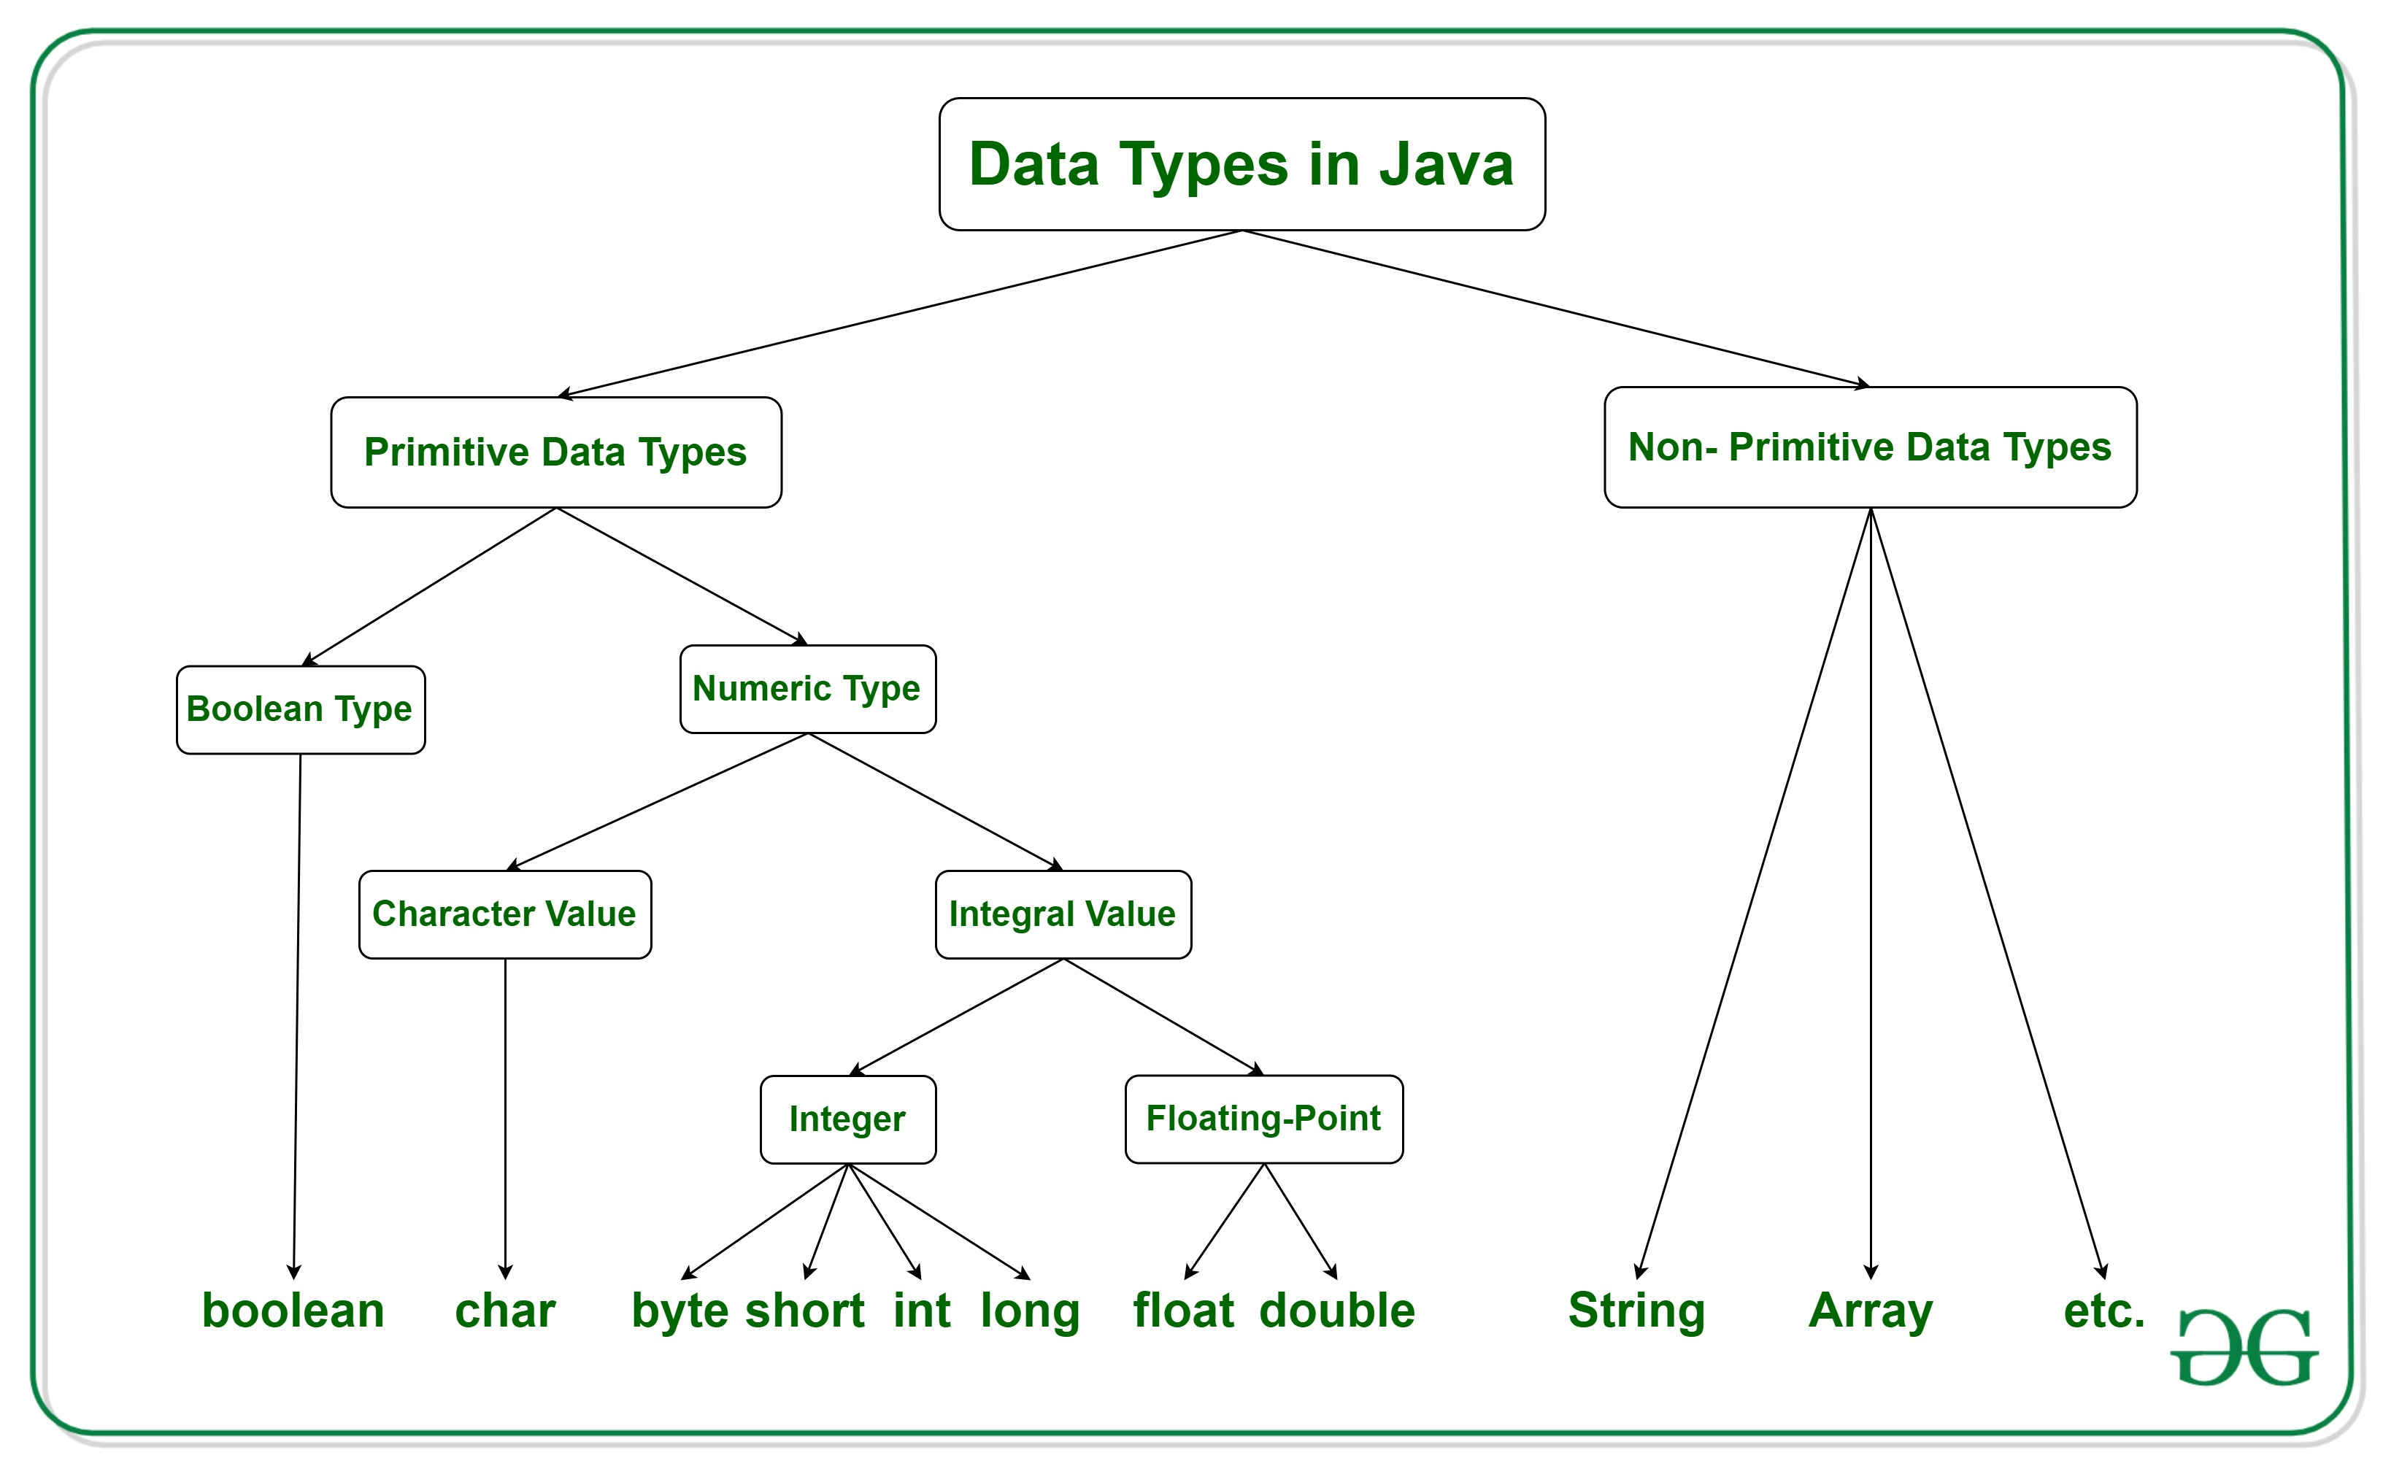
Data Types
Variable must be of a specified data type
Data Types are divided into two groups: primitive and non-primitive data type

Slide 8
Primitive vs non-primitive Data Types
Primitive data type always has a value and starts with a lowercase letter
Non-primitive data type can be null and starts with a uppercase letter
Primitive data type includes:
  byte, short, int, long, float, double, boolean and char
Non-primitive data type includes:
  String, Arrays and Classes

Slide 9
Primitive Data Types
Data Type | Size | Description
byte | 1 byte | Stores whole numbers from -128 to 127
short | 2 bytes | Stores whole numbers from -32,768 to 32,767
int | 4 bytes | Stores whole numbers from -2,147,483,648 to 2,147,483,647
long | 8 bytes | Stores whole numbers from -9,223,372,036,854,775,808 to 9,223,372,036,854,775,807
float | 4 bytes | Stores fractional numbers. Sufficient for storing 6 to 7 decimal digits
double | 8 bytes | Stores fractional numbers. Sufficient for storing 15 decimal digits
boolean | 1 bit | Stores true or false values
char | 2 bytes | Stores a single character/letter or ASCII values

Slide 10
Non-Primitive Data Type - Array
Arrays are used to store multiple values in a single variable, instead of declaring separate variables for each value.
An array can be of any data-type (int, float, boolean, char...etc, or even user-defined data type).
For instance, you need to read 100 numbers, compute their average, and find out how many numbers are above the average. Declaring int x1,x2,x3,x4...,x99,x100?
In this case, using Array would be a better option.

Slide 11
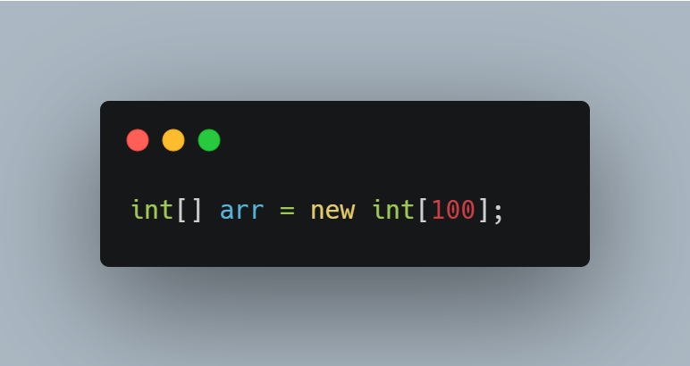
Defining a Java Array
Let’s create an array of 100 integers:

Slide 12
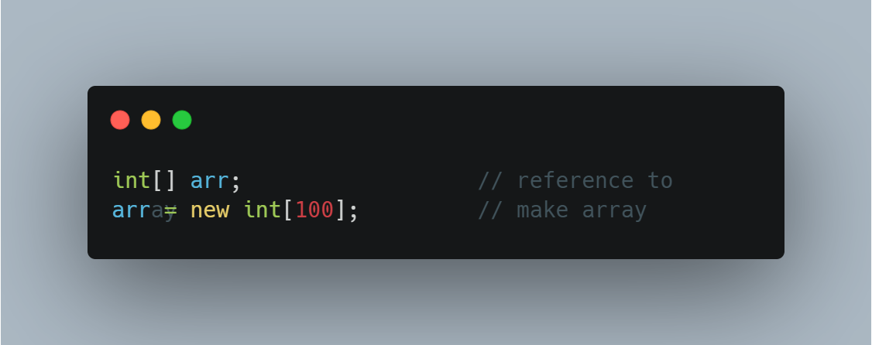
We said an array was a reference…
That means if we do this:
What exactly does arr contain?

Slide 13
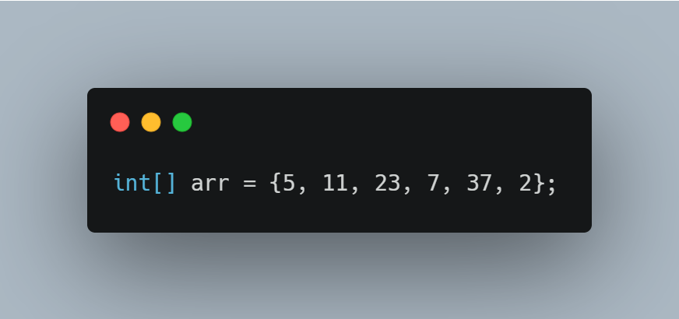
Defining a Java Array with data
Automatically determines the size
Can do this with primitives or objects

Slide 14
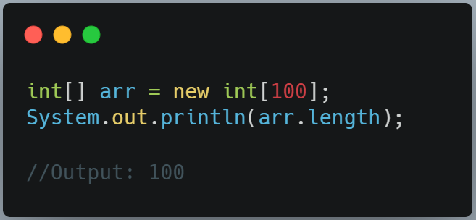
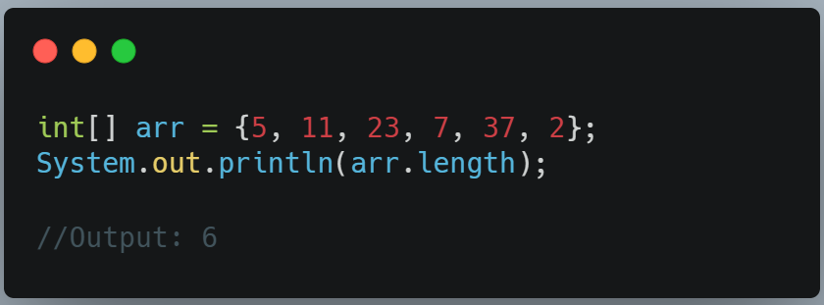
The Size
Size of an array cannot change once it’s been declared:
But, one nice thing is that arrays are objects. So you can access its size easily:

Slide 15
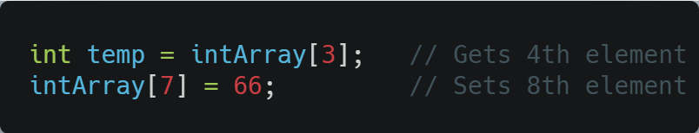
Access
Done by using an index number in square brackets:
How do we access the last element of the array, if we don’t remember its size?
What range of indices will generate the IndexOutOfBounds exception?

Slide 16

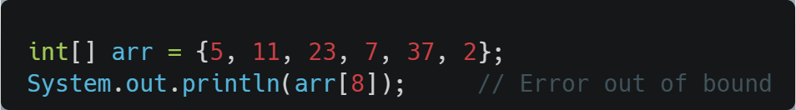
Access
How do we access the last element of the array, if we don’t remember its size?
What range of indices will generate the IndexOutOfBounds exception?
  Index less than 0 or index equal array length and above
The index start at 0.

Slide 17


Initialization
What do each of the elements of this array contain:
How about this one:
  What happens if we attempt to access one of these values?

Slide 18
Initialization
What do each of the elements of this array contain:
  Each of the element is an int
How about this one:
  What happens if we attempt to access one of these values?
    The reference to a BankAccount, it’s an object

Slide 19
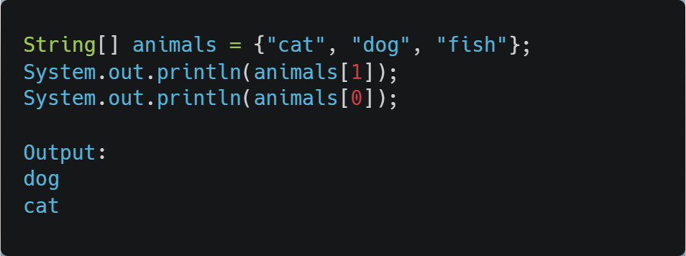
Using Array
We can specify which element in the array we want to access by provide an index.
Array index start at 0,

Slide 20
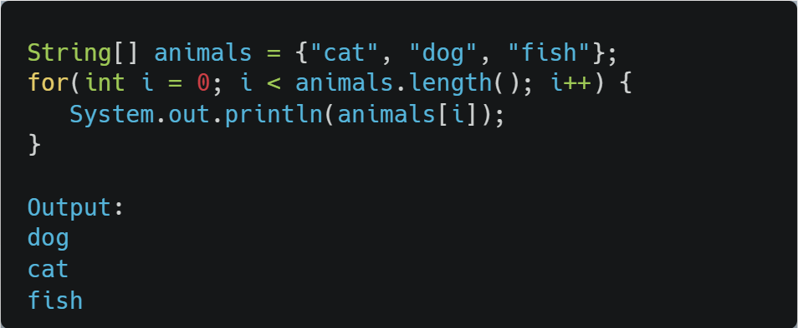
Loop through an Array
You can loop through the array elements with the for loop,
Use the length property to specify how many times the loop should run.
Example:

Slide 21
Look at a book example…
See the example on p. 41-42, where we do the following:
  Insert 10 elements into an array of integers
  Display them
  Find item with key 66
  Delete item with key 55
  Display them
Ask ourselves:
  How could we make the initialization shorter?
  How could we save declaring nElems?

Slide 22
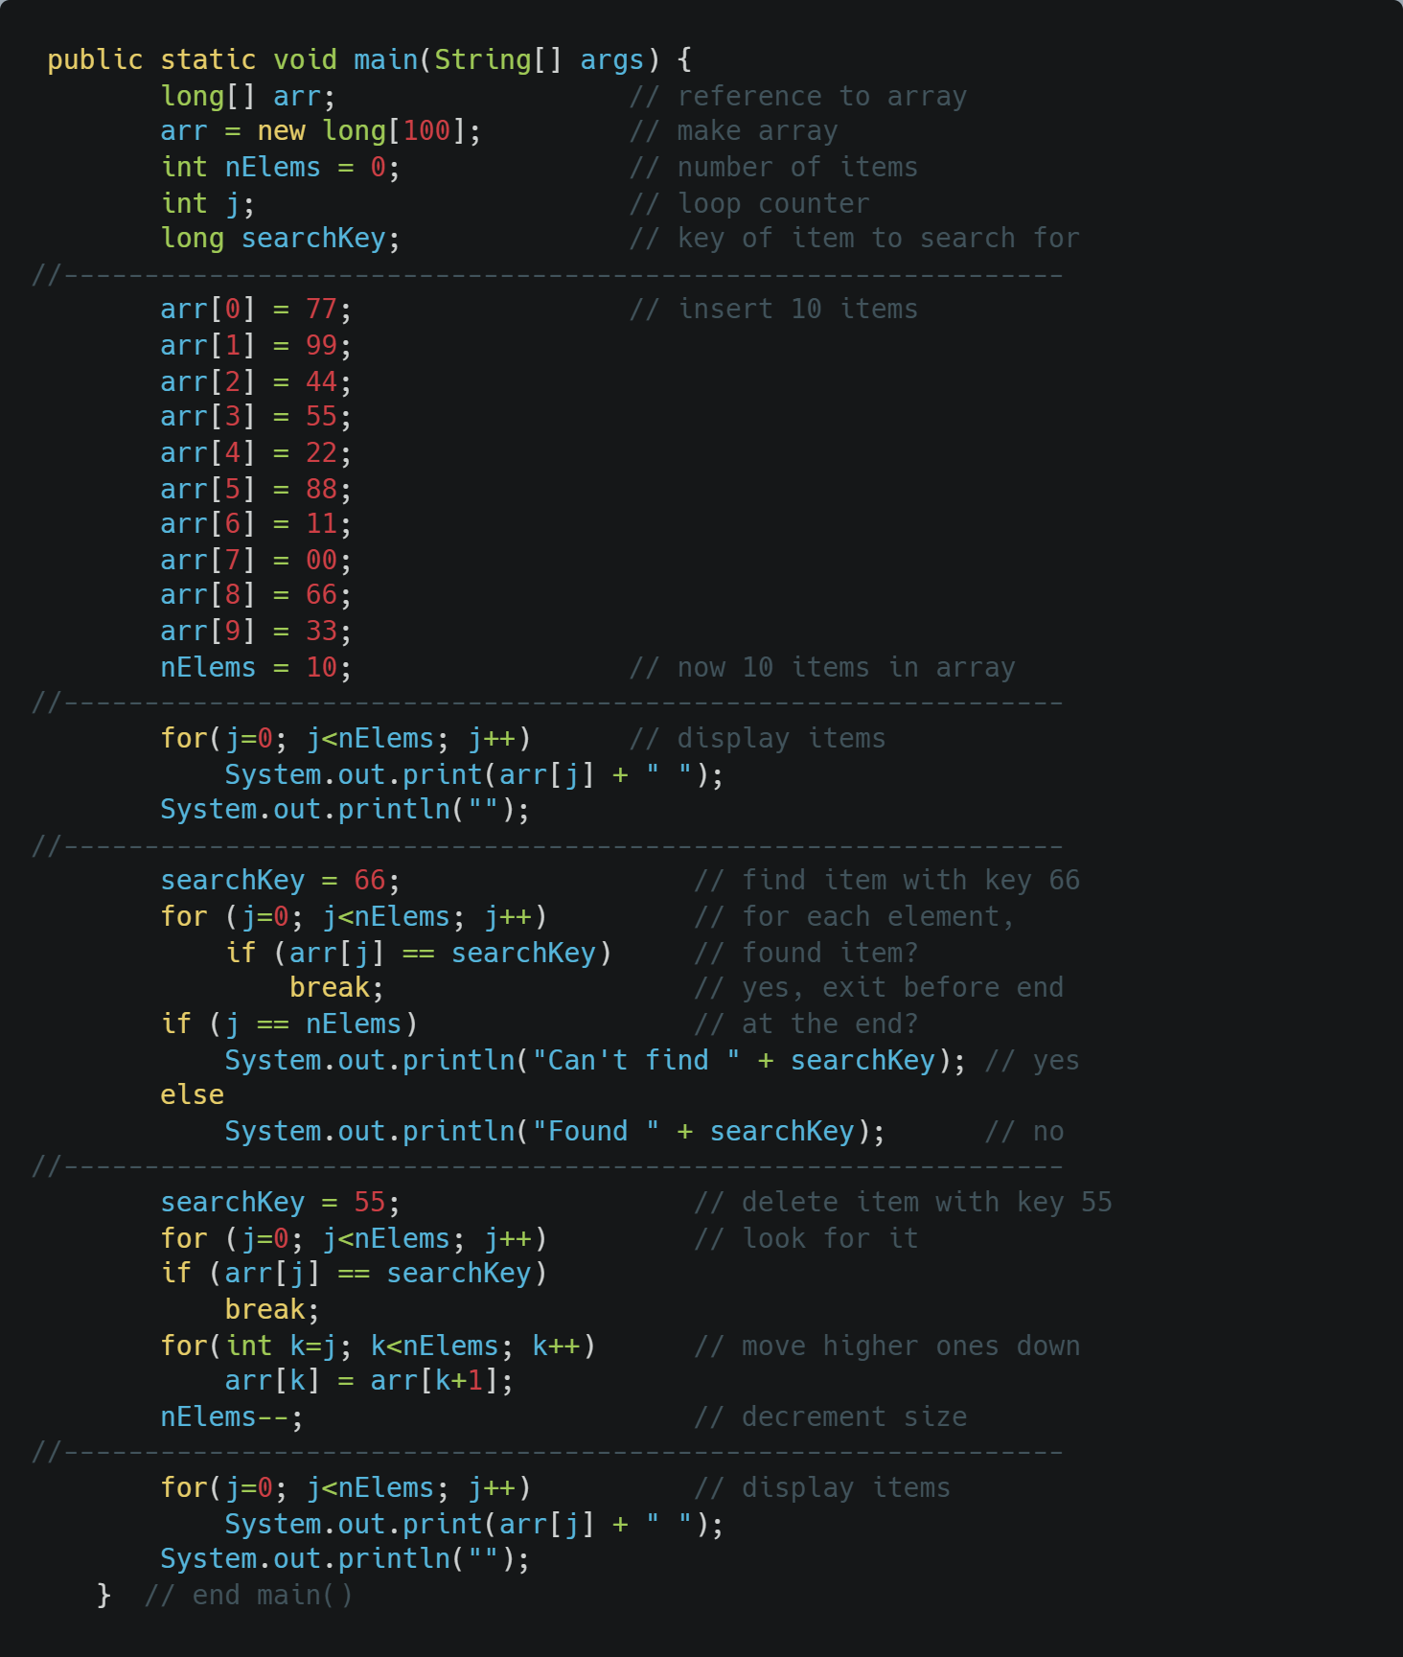
Look at a book example
See the example on p. 41-42

Slide 23
The Array.java
https://github.com/biblelamp/JavaExercises/blob/master/Algorithms/array/array.java
What operations would be nice to have?
How do we insert new element?
How to Search?
How to Delete?

Slide 24
This did not use OOP
So our next task will be to divide it up (p. 45)
What will we want for the array class? Let’s think about the purpose of classes. They have data, and functions to manipulate that data.
So in this case, what will our data be?
For functions, we’ll provide:
  A constructor which takes a size and initializes the array
  A function to retrieve a single element
  A function to set a single element
And then modify main()

Slide 25
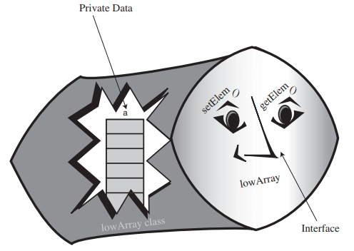
The LowArray interface
Here’s what it looked like:

Slide 26
What does it mean “Interface”
An interface is the boundary or contract that defines how two different software components or systems interact, exchange data, and use each other's functions.
The LowArray interface: sets of methods that can be called to used
Example: BasicCalculator java class from assignment 0
  Offers set of functions like addition, subtraction,…etc. for other classes to call and use
Think of our Array class, what kind of function do we need?

Slide 27
The LowArray interface​
Member Variables:
  long[] a
Constructor:
  LowArray(int size)
Methods:
  void setElem(int index, long value)
  int getElem(int index)

Slide 28
The LowArray interface
Link to LowArray:
  https://github.com/biblelamp/JavaExercises/blob/master/Algorithms/array/lowArray.java

Slide 29
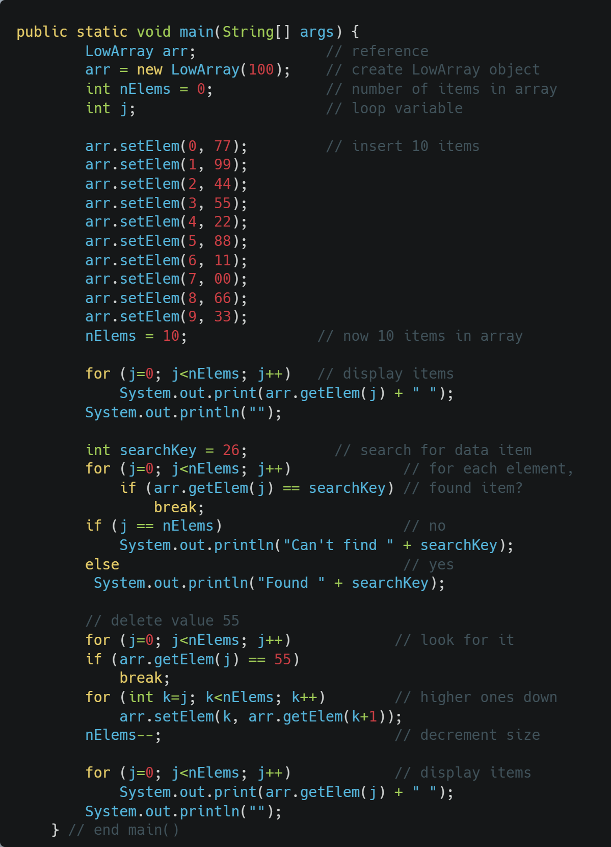
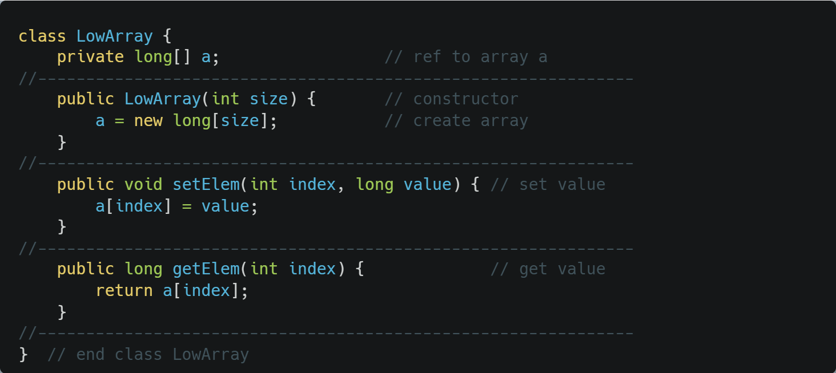
The LowArray interface

Slide 30
The LowArray interface
Link to LowArray:
  https://github.com/biblelamp/JavaExercises/blob/master/Algorithms/array/lowArray.java
What’s inadequate currently in terms of operations?
How can we improve things?

Slide 31
The LowArray interface
What’s inadequate currently in terms of operations?
  Cannot tell us which element in the array is occupied and which are free
How to improve on that?
  Some sort of counter that point to the next element that is not occupied?

Slide 32
The HighArray interface
Let’s make a new HighArray class (p. 49) which includes the following functions:
  Constructor which takes an integer for the size
  Function to access an element
  Function to insert an element
  Function to find an element
  Function to delete an element
One more member variable
  nElems, which holds the number of occupied cells
Then, let’s modify main().

Slide 33
The HighArray interface
Link to HighArray
  https://github.com/biblelamp/JavaExercises/blob/master/Algorithms/array/highArray.java

Slide 34
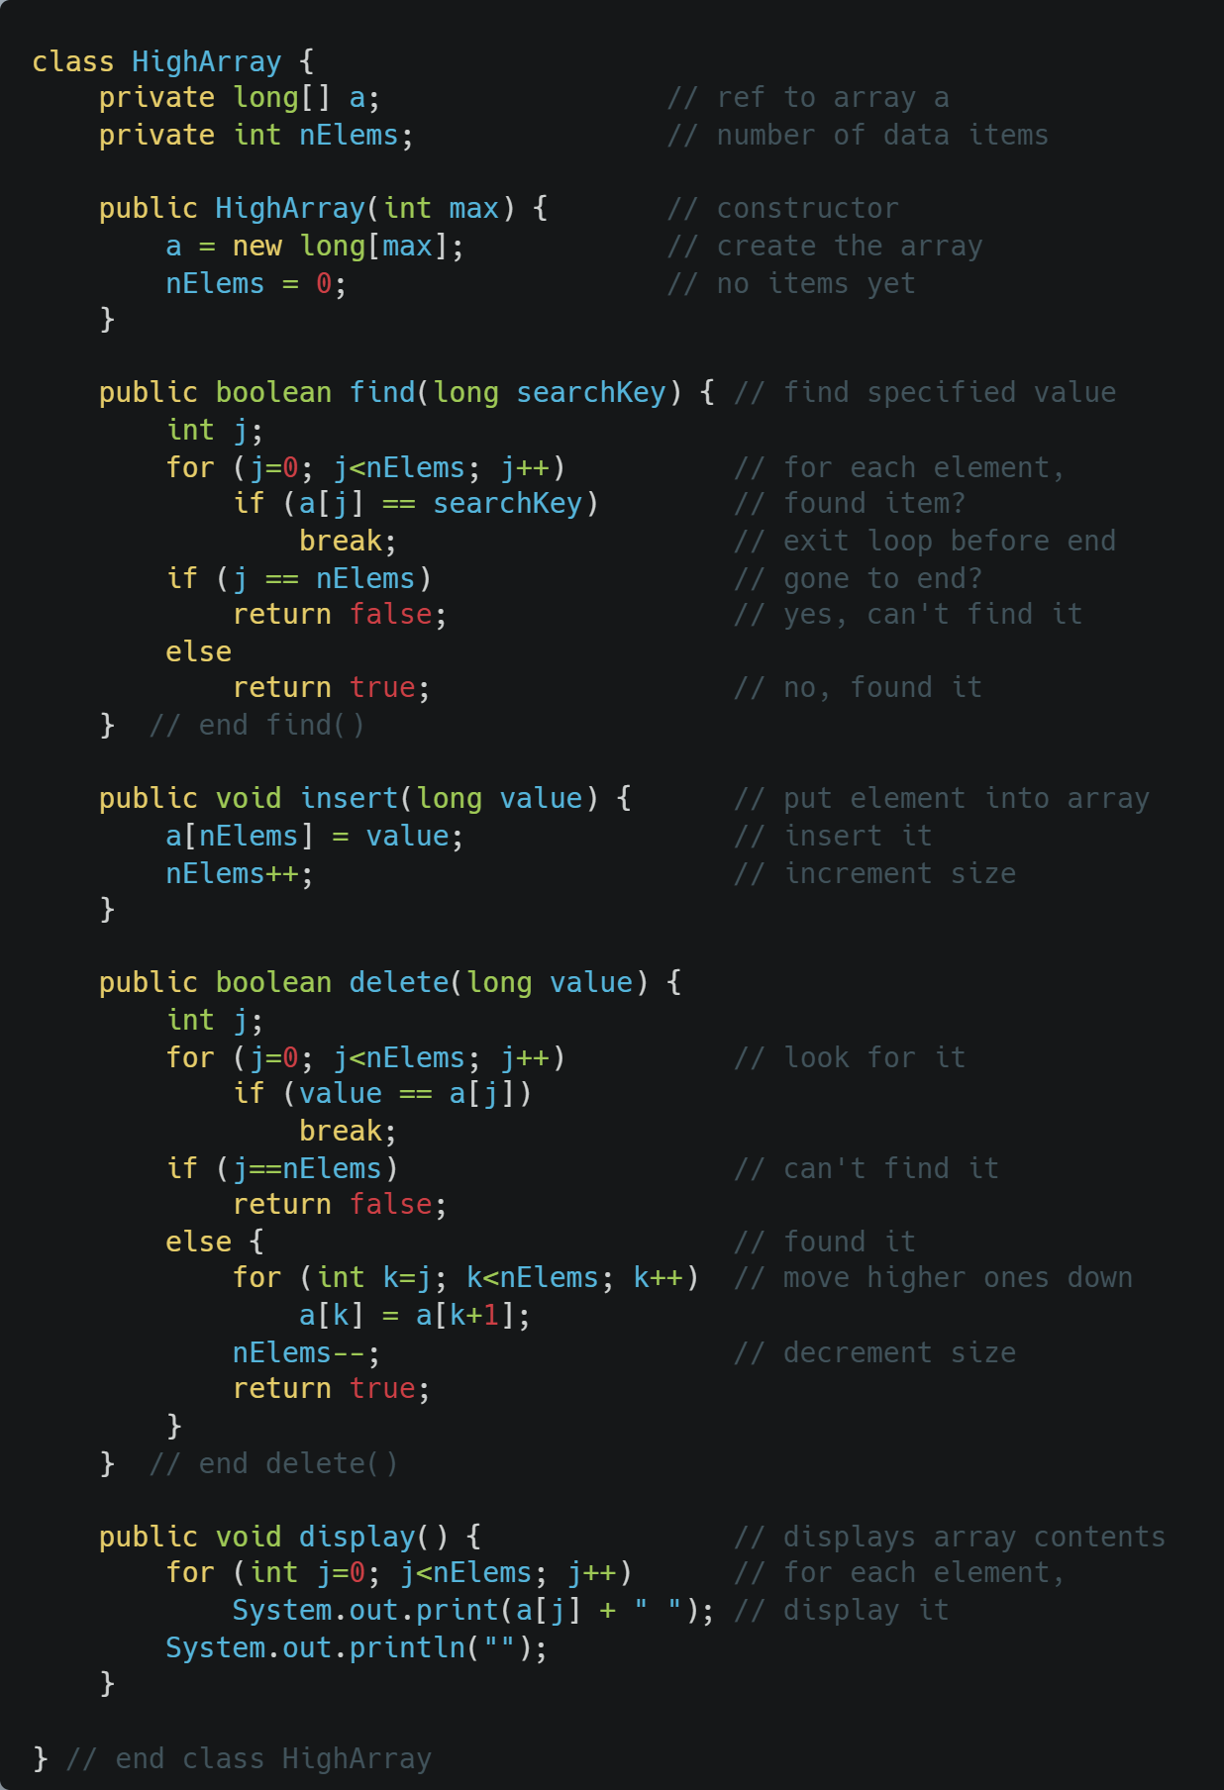
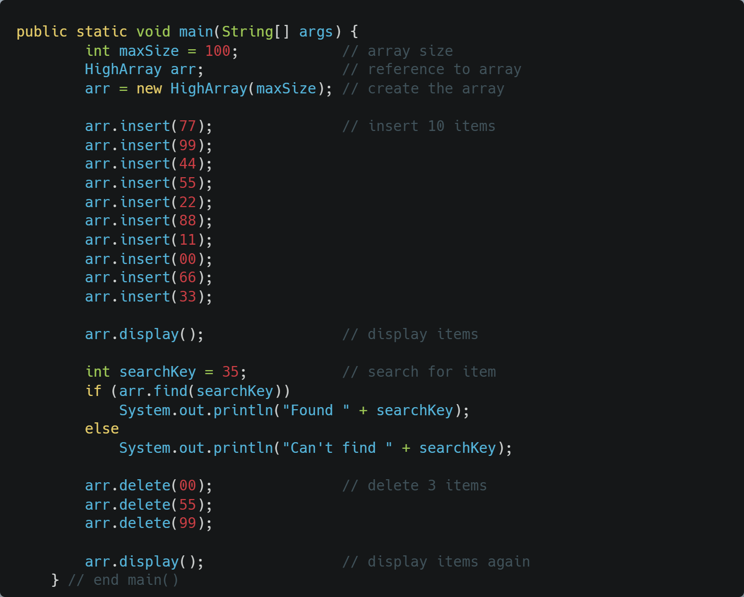
The HighArray interface

Slide 35
Abstraction
This illustrates the concept of abstraction
  The way in which an operation is performed inside a class is invisible
  Client of HighArray performs more complex operations through simple method invocations
    Never directly accesses the private data in the array
Now we can reuse HighArray much easier
  Note – a client does not even really know about the member array

Slide 36
HighArray’s Operations
Constructor: create new HighArray
Insert: insert element into the HighArray
Search: find an element in the HighArray
Delete: find an element then delete if exist in the HighArray

Slide 37
Constructor
The constructor is called when we initialized the HighArray class
It should perform actions that we need when freshly creating a new instance of this HighArray class
What should our constructor do? Anything we need to do in the beginning?
Does it need any parameters?

Slide 38
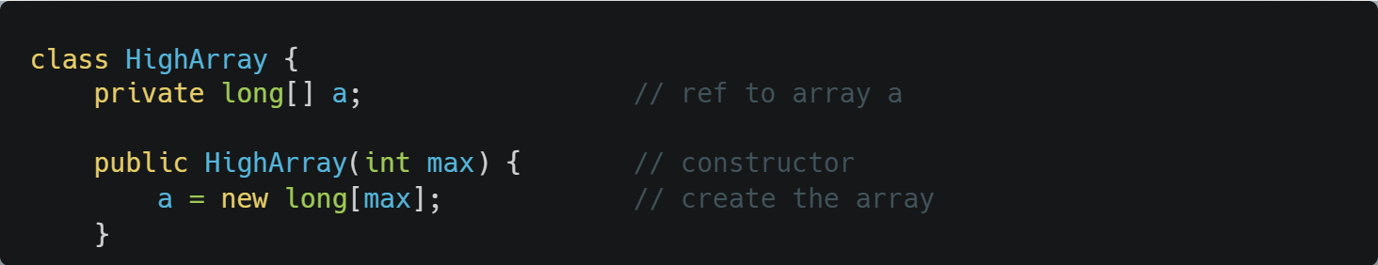
Constructor
The constructor should create a new Array
The new array will need the user to give a specific size
Now users should be able to create new HighArray and give it the specific size as needed, it will then initialize new Array with the given size, inside the HighArray

Slide 39
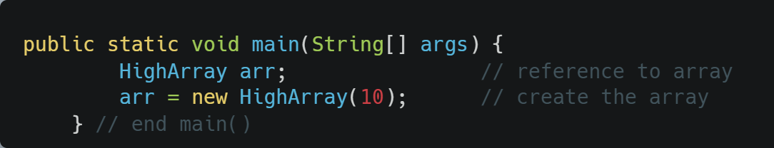

Constructor
Let’s use our HighArray class in our main java class
Now we have initialed a new HighArray object called arr
Inside the this arr there is an Array with size 10 that initially empty:

Slide 40
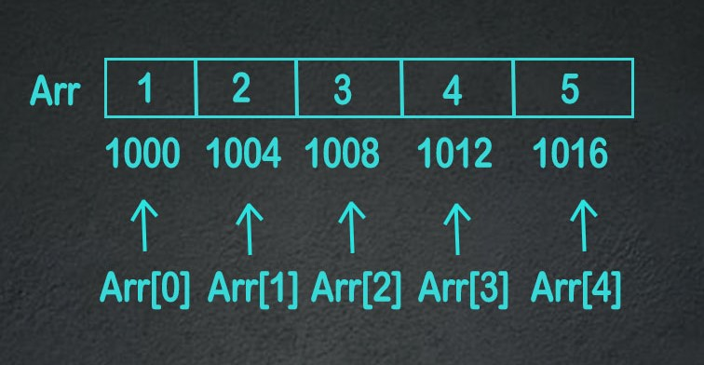
Access an element
What is the time complexity?

Slide 41
Insert an element
We have an empty array, so now how do we add data in?
  Here is our newly initialized array called arr with size 10:
How do we insert a new element into the array?
Do we need to modify or add anything?

Slide 42
Insert an element
We will need a pointer to know where the next empty place inside the array to add new data
New elements coming in, will be store at where the pointer is points
Then we will move the pointer forward by one slot

Slide 43
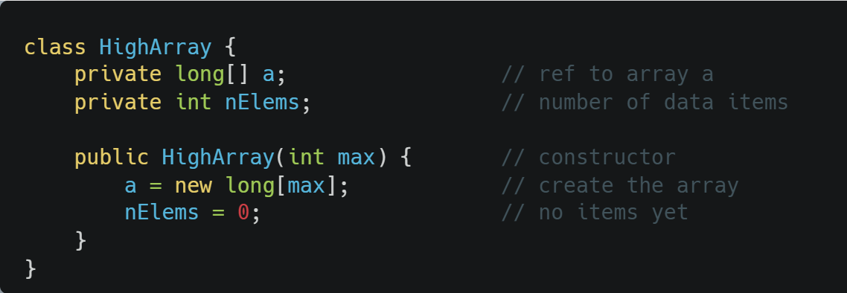
Insert an element
The pointers can just be an int nElems
  It store the index
Let modify and add this pointer in our HighArray class, including the constructor
Do our insert method need any parameter?

Slide 44
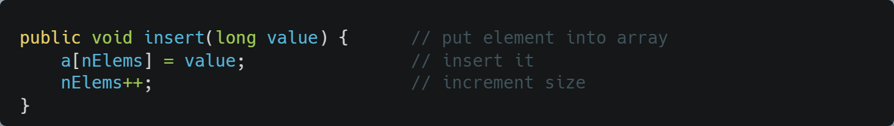
Insert an element
Our insert method:
One parameters which is the new element
Store it at nElems
Then move nElems to the next index

Slide 45
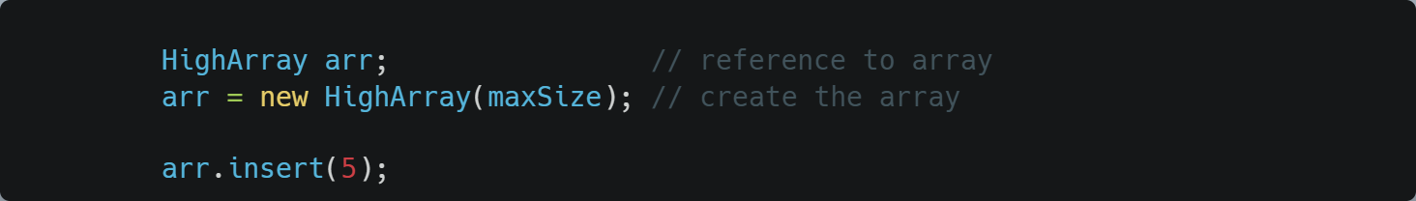

Insert an element
In our main, when we add new elements:
New element is store at the pointer nElems and it will move by one

Slide 46
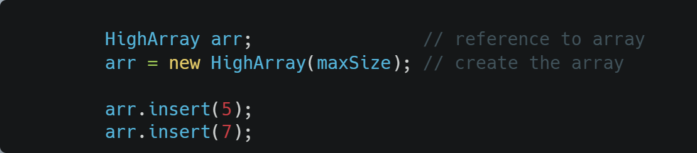

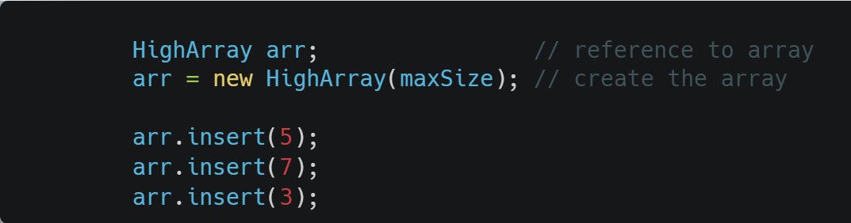

Insert an element
Let’s insert more elements
So what is the time complexity for insert?

Slide 47

Search for an element
Let’s fill our array
How do we search?
What parameter do our search method need?
What searching algorithms should we use?
  Binary search?
  Linear/Brute Force search?

Slide 48
Search for an element
Let’s fill our array
The array is an UnorderedArray, meaning it is not sorted so we cannot use Binary Search
Binary Search can only be used if the linear data is sorted
Let’s use Linear/Brute Force Search as the algorithm for searching method in this UnorderedArray (HighArray)
Note: UnorderedArray is the correct term of this type of array
    HighArray is just a name used by the book to describe interface implementation

Slide 49
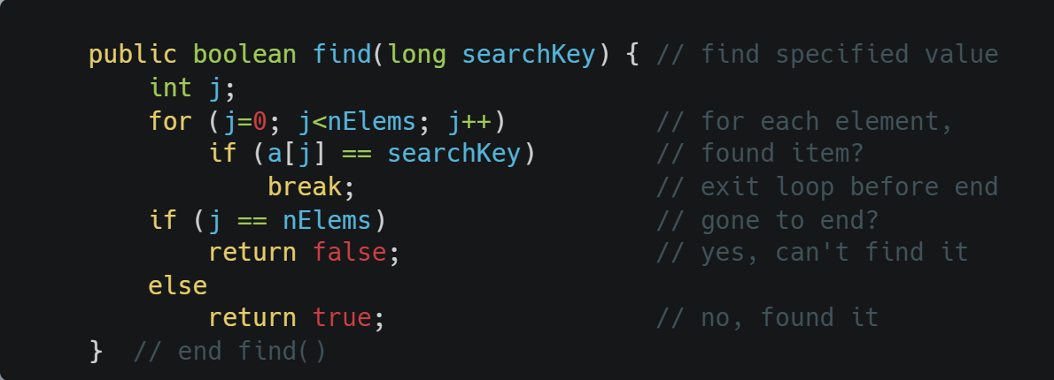
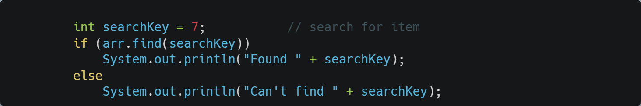
Search for an element
In the book example, it return true if found and false if not found
We could also implement it to return the index instead
Implementation of our search method
Usage in main:
Print out result if 7 is found or not

Slide 50
Search for an element
What is the time complexity for searching in this UnorderedArray?

Slide 51
Delete an element
How should our delete methods be?
Need any parameters? What are they?
How to implement it?
Any possible problem?

Slide 52
Delete an element
Let have our delete method take in an element as parameter:
  Search for that element
  If found:
    Remove
    Return True
  If not found:
    Return False
What if the element is in the middle of the array?
  How to handle this?

Slide 53
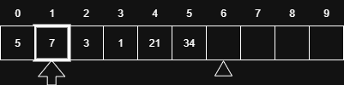
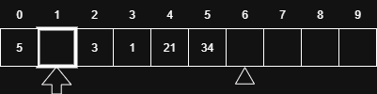
Delete an element
What if the element is in the middle of the array?
  How to handle?
Let say we want to remove 7:
We remove 7, then there is a hole here. How to handle this?

Slide 54


Delete an element
We will need to shift everything over by one
Now next time we do insert, there won’t be any problem.
What is the time complexity for delete?

Slide 55
Time Complexity for Unordered Array
Insert: insert element into the HighArray
  O(1) just add to the end
Search: find an element in the HighArray
  O(n) one by one till found or end
Delete: find an element then delete if exist in the HighArray
  O(n) find, delete, then shift all from target
Access: Retrieve an element at a specific index in the HighArray
  O(1) You can directly retrieve any element by index in constant time, because arrays use contiguous memory and the element’s address can be calculated immediately

Slide 56
The Ordered Array
An array in which the data items are arranged in ascending order or descending order
Descending order
  Smallest value is at the first index
  Largest value is last index
Think about what functions we’d have to modify
Why could this be a nice feature? What operation could be much faster?
Why do we want an ordered Array?

Slide 57
That’s right, searching!
We can still do a linear search, which is what we’ve seen.
  Step through the elements
In the average case, would this be faster than an unordered array?
We can also do what’s called binary search, which is much faster
  Especially for large arrays

Slide 58
The Ordered Array vs Unordered Array
Very similar only different is that each operation like insert now must make sure that new element is insert to the right order (ascending or descending) depends on the current element existed in the array
Differences:
  Find() change from Linear Search to Binary Search
  Insert() make used of Linear Search to insert to the array
  Delete() use find() to delete element from the array

Slide 59
Binary Search: Idea
Ever see the Price is Right?
  Guess the price on an item
  If guess is too low, Bob Barker says “higher”
  If guess is too high, Bob Barker says “lower”
This can work if we are using ordered arrays
  Check the middle element
  If it’s too low, restrict search to the first half of the array
  Otherwise restrict search to the second half of the array
  And repeat.

Slide 60
Note what this can save!
Let’s take a simple case, where we search for an item in a 100-element array:
  int[] arr = {1,2,3,4,5,6,…..,100}
For an unordered array where we must use linear search, how many comparisons on average must we perform?
How about for binary search on an ordered array? Let’s look for the element 33.

Slide 61
Binary Search
Array has values 1-100
First search: Check element 50
  50 > 33, so repeat on first half (1-49)
Second search: Check element 25
  25 < 33, so repeat on second half (26-49)
Third search: Check element 37
  37 > 33, so repeat on first half (26-36)
Fourth search: Check element 31
  31 < 33, so repeat on second half (32-36)
Fifth search: Check element 34
  34 > 33, so repeat on first half (32-33)
Sixth search: Check element 32
  32 < 33, so repeat on second half (33)
Seventh search: Check element 33! Found.
So 7 comparisons. With linear search, it would’ve been 33.

Slide 62
Affect on Operations
We saw how binary search sped up the searching operation
Can it also speed up deletion?
What about, insertion of a new element into an ordered array?

Slide 63
Implementation
Let’s go through the Java implementation, on pages 56-57.
At any given time:
  lowerBound holds the lower index of the range we are searching
  upperBound holds the upper index of the range we are searching
  curIn holds the current index we are looking at
What if the element is not in the array? What happens?
Link:
  https://github.com/biblelamp/JavaExercises/blob/master/Algorithms/array/orderedArray.java

Slide 64
Now, let’s implement the OrdArray
Data
  The array itself
  The number of occupied slots
Methods
  Constructor
  Size
  Find (with binary search)
  Insert (with binary search)
  Delete (with binary search)
  Display

Slide 65
Analysis
What have we gained by using ordered arrays?
Is searching faster or slower?
Is insertion faster or slower?
Is deletion faster or slower?
All in all, ordered arrays would be useful in situations where insertion/deletion are infrequent, but searching is frequent
  Employee records – hiring/firing is less frequent than accessing or updating an employee record

Slide 66
Ordered Array: Operation Counts
Maximum number of comparisons for an ordered array of n elements, running binary search:
n Comparisons
10 4
100 7
1000 10
10000 14
100000 17
1000000 20
How does this compare with linear search, particularly for large arrays? Whew.

Slide 67
A Deeper Analysis
How many comparisons would be required for an array of 256 elements? (2^8)
What about 512 (2^9)?
What do you think 1024 would be (2^10)?
See the pattern?
So for n values, the number of comparisons is log₂(n)+1.
This is an example of an algorithm which scales logarithmically with the input size. Linear search, scales linearly.

Slide 68
Computing log₂n
On a calculator, if you use the “log” button, usually the base is 10. If you want to convert:
  Multiply by 3.322
Algorithms that scale logarithmically are preferable to those that scale linearly, because the log of a function grows much slower than the function itself. O(logn) is better than O(n).
So for large input sets, you’ll have a MUCH smaller number of operations.

Slide 69
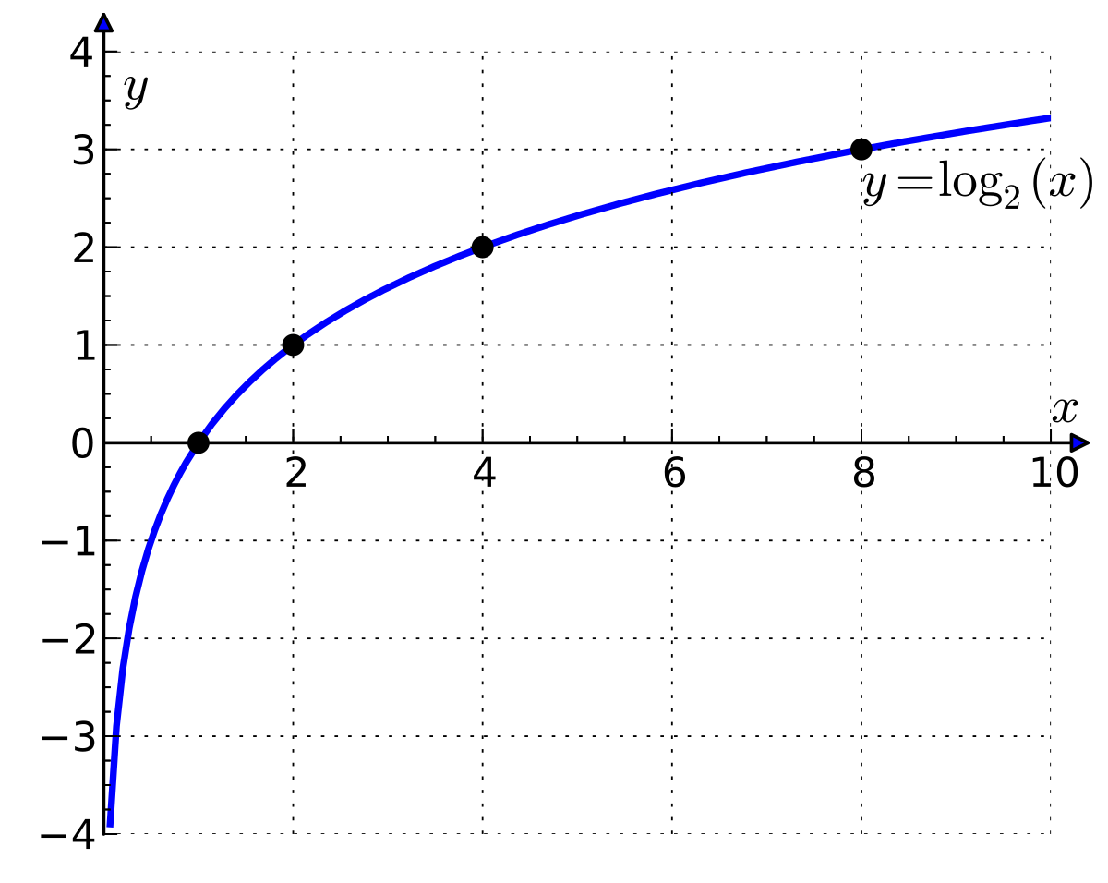
Computing log₂n
2² = 4
2³ = 8
2⁴ = 16
2⁵ = 32
log₂(4) = 2
log₂(8) = 3
log₂(16) = 4
log₂(32) = 5
log₂(x) mean 2 to the power of what value to get x

Slide 70
Storing Objects
We’ve seen an example where we used arrays to store primitive data. Now let’s look at an example which stores objects. What’s our situation now with values and references?
The array itself is still a reference
The elements of the array are reference
Implications?

Slide 71
Person Class
Let’s go through the Person class on page 65.
Data:
  First name and last name (String objects), age (integer value)
Functions
  Constructor which takes two strings and an integer
  Function to display information
  Function to return the last name (we’ll eventually use this for searching)

Slide 72
Adapting our HighArray class
Rewrite the implementation on page 49
Change to operate on Persons instead of integers
Watch out for the ==!
In main() construct Person objects

Slide 73
Big-Oh Notation
Provides a metric for evaluating the efficiency of an algorithm
Analogy: Automobiles
  Subcompacts
  Compacts
  Midsize
  etc.

Slide 74
How it’s done
It’s difficult to simply say: A is twice as fast as B
We saw with linear search vs. binary search, the comparison can be different when you change the input size. For example, for an array of size n:
n=16, linear search comparisons = 10, binary search comparisons = 5
  Binary search is 2x as fast
n=32, linear search comparisons = 32, binary search comparisons = 6
  Binary search is 5.3x as fast

Slide 75
Example: Insertion into Unordered Array
Suppose we just insert at the next available position:
  Position is a[nElems]
  Increment nElems
Both of these operations are independent of the size of the array n. Which mean no matter the size of the array, the steps it take to insert into unordered array is O(1) constant.
So they take some time, K, which is not a function of n
We say this is O(1), or constant time
Meaning that the runtime is proportional to 1.

Slide 76
Example: Linear search
You’ll require a loop which runs in the worst case n times
Each time, you have to:
  Increment a loop counter
  Compare the loop counter to n
  Compare the current element to the key
  Each of these operations take time independent of n, so let’s say they consume a total time of K.
Then the algorithm would take K*n total time
We say this is O(n).

Slide 77
Example: Binary Search
We’ve already said that for an array of n elements, we need log(n)+1 comparisons.
  Each comparison takes time independent of n, call it K
Total time is then: K(log(n)+1) = K*log(n) + K
For large n, this grows proportional to log(n), i.e. the leading term dominates.
We say this is O(log n)

Slide 78
Why this is useful
Useful to evaluate how well an algorithm scales with input size n. For example:
  O(1) scales better than…
  O(log n), which scales better than…
  O(n), which scales better than…
  O(n log n), which scales better than…
  O(n^2), etc.
Each of these successively grows faster with n.

Slide 79
Generally speaking…
For an input of size n and a function T(n), to compute the Big-Oh value, you take the leading term and drop the coefficient.
Examples – compute Big Oh values of the following runtimes:
  T(n) = 100*n^2 + n + 70000
  T(n) = (n*log n) / n
  T(n) = n^3 + 754,000*n^2 + 1
  T(n) = (n + 2) * (log n)

Slide 80
Generally speaking… (Answered)
For an input of size n and a function T(n), to compute the Big-Oh value, you take the leading term and drop the coefficient.
Examples – compute Big Oh values of the following runtimes:
  T(n) = 100*n^2 + n + 70000 O(n^2)
  T(n) = (n*log n) / n O(logn)
  T(n) = n^3 + 754,000*n^2 + 1 O(n^3)
  T(n) = (n + 2) * (log n) O(n)

Slide 81
But, these large constants must mean something…
  T(n) = n^3 + 754,000*n^2 + 1
This huge constant on the n^2 term, has to have some effect, right?
The answer is yes and no.
Yes, if the input size is _________________.
But for very large values of n, n^3 overtakes the term, even with the large constant.

Slide 82
Algorithms we’ve discussed…
Linear search: O(n)
Binary search: O(log n)
Insertion, unordered array: O(1)
Insertion, ordered array: O(n)
Deletion, unordered array: O(n)
Deletion, ordered array: O(n)

Slide 83
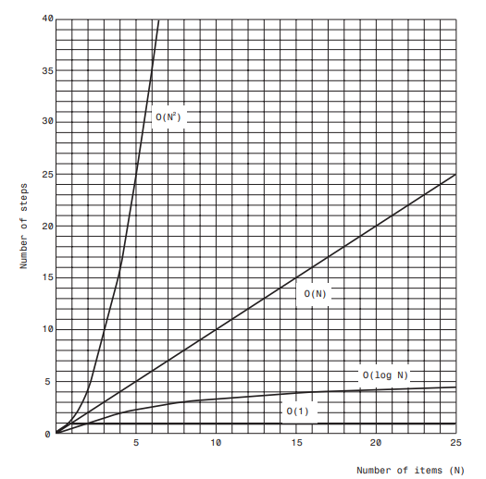
Graph of
Big O times.

Slide 84
Unordered Array Characteristics
What is the time complexity of insert new element?
What is the time complexity of searching an element?
What is the time complexity of deleting an element?

Slide 85
Unordered Array Characteristics (Asnwered)
What is the time complexity of insert new element?
  O(1) always insert at the end of the array
What is the time complexity of searching an element?
  O(n)
What is the time complexity of deleting an element?
  O(n)

Slide 86
Ordered Array Characteristics
What is the time complexity of insert new element?
  Does the searching algorithm matter here?
What is the time complexity of searching an element?
What is the time complexity of deleting an element?
  Does the searching algorithm matter here?

Slide 87
Ordered Array Characteristics (Asnwered)
What is the time complexity of insert new element?
  O(n) no matter the search algorithm, it will still need to rearrange the rest of the elements in the array to insert
  Can switch to use Binary search instead of Linear search for a small improvement
  However (n + logn) or (n + n) is still O(n)
What is the time complexity of searching an element?
  O(log n)
What is the time complexity of deleting an element?
  O(n) no matter the search algorithm
  (n + logn) or (n + n) is still O(n)

Slide 88
Unordered/Ordered Array Tradeoffs
Unordered (Unsorted)
  Insertion is fast – O(1)
  Searching is slow – Linear Search O(n) Note: Linear Search is Brute Force Search
Ordered (Sorted)
  Searching is fast – Binary Search O(log n)
  Insertion is slow – O(n)
Deletion is even – O(n)
Memory can be wasted, or even misused. Let’s discuss.

Slide 89
Array Memory Wasted
When an array is declared, its size must be fixed and allocated at compile time
All elements in the array need to be initialized even if they are not used
Causing slow delete and insert

Slide 90
What we will see…
There are structures (trees) which can insert, delete and search in O(log n) time
  Of course as you’d expect, they’re more complex
We will also learn about structures with flexible sizes
java.util has class Vector – what you should know:
  Array of flexible size
  Some efficiency is lost (why do you think?)
    What happens when we try to go beyond the current size?
    Why is this penalty very large at the beginning of array population?

